Slide 1
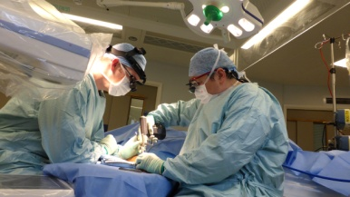
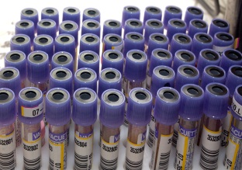
Creating a Nightingale Hospital The Good, The Bad, The Ugly
NYHDIF, 15 May 2020
Cindy Fedell
Chief Digital & Information Officer, Bradford Teaching Hospitals NHS Foundation Trust
Senior Responsible Officer - Digital, West Yorkshire & Harrogate Health & Care Partnership
@CindyFedell
Notes:
30 minutes – 25 minute presentation and 5 minutes for questions
= 10 slides

Slide 2
Nightingale Hospital Yorkshire & the Humber
400 beds
In a convention centre
ITU Level 3 only (now some Level 2 beds)
Leeds Teaching Hospitals the host Trust
True Yorkshire & Humber – staff from across the health and care sector in all the ICSs
@CindyFedell
Notes:
own, npfit, make do
1st 2 weeks, no integration of dig into workflow; something else someone else did
Attention from the centre dq = poor people/process/tech combo (golden triangle)
Big hill
Eager; but zero confidence
Needed to show people what good looked like, started with Board-approved Guiding Principles
Importance of good data – not just at the minute use

Slide 3
Starting with The Challenge
Requirements
Pathology is to be done at HDFT
Clinicians will be from a wide range of Hospitals
An ITU Level 3 use case
1 week concept to deployment timeframe
Principles & Learning from Excel
Use the fastest & safest way
Tried & tested information systems & interfaces, in particular Pathology
Using ‘in production’ tech from a Trust
Reliable and resilient kit, in particular network
Scalable base infrastructure as requirements changed
Leverage suppliers wherever you can
What did others do?
Digital provision the same as other ITU sites (Birmingham, Excel)
Very few Trusts in the UK are digitally mature in ITU
@CindyFedell
Notes:
own, npfit, make do
1st 2 weeks, no integration of dig into workflow; something else someone else did
Attention from the centre dq = poor people/process/tech combo (golden triangle)
Big hill
Eager; but zero confidence
Needed to show people what good looked like, started with Board-approved Guiding Principles
Importance of good data – not just at the minute use

Slide 4
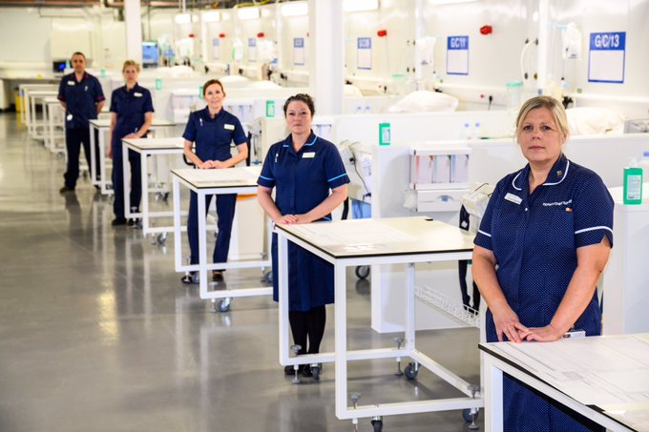
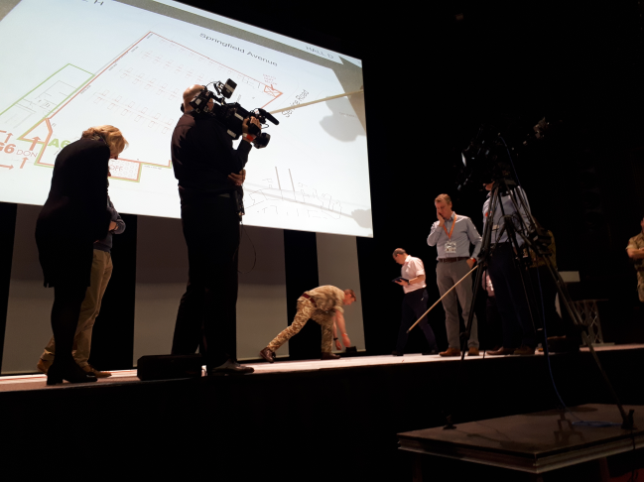
The Good
Agile at its best
2x daily sprints with all teams – stand on your X
Everyone committed to a common goal
People from everywhere, including consulting, suppliers, the army
No politics & no hierarchy
Dynamic work streams (changed as needed)
Clin, Ops, Path, Rad, HR, Dig, Pharm, Supplies, Comms, Army
Dynamic work plan - tasks, time, critical path, resources
Every requirement, every decision, every conversation – in person
The army bought some of their methods - ROC
On the spot £m decisions - is it the right thing & the right supplier?
And they were good decisions!
@CindyFedell
Notes:
own, npfit, make do
1st 2 weeks, no integration of dig into workflow; something else someone else did
Attention from the centre dq = poor people/process/tech combo (golden triangle)
Big hill
Eager; but zero confidence
Needed to show people what good looked like, started with Board-approved Guiding Principles
Importance of good data – not just at the minute use

Slide 5
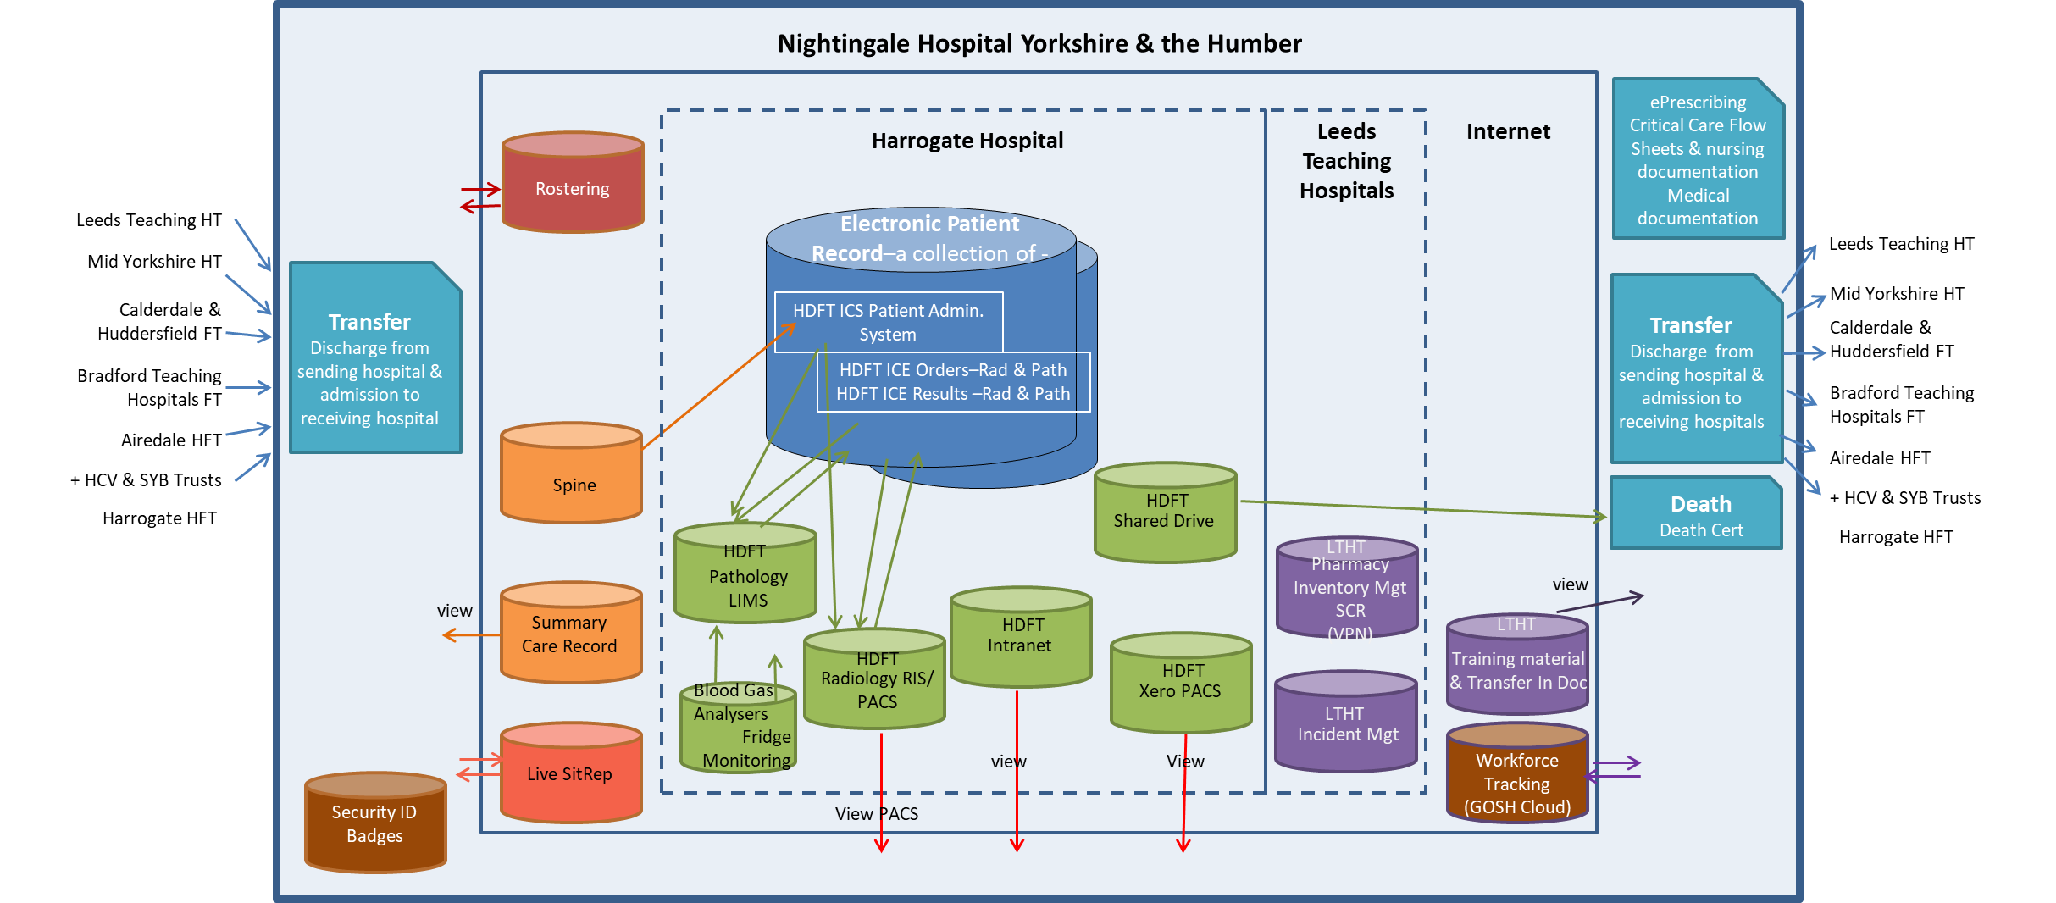
Digital Model
Our core team
CIO Nightingale (WY&H/BTHFT)
CCIO Nightingale (WY&H/AHFT)
CDIO LTHT & team
AD-P&I HDFT & team
2 consulting companies
Many suppliers
Army
@CindyFedell
Notes:
own, npfit, make do
1st 2 weeks, no integration of dig into workflow; something else someone else did
Attention from the centre dq = poor people/process/tech combo (golden triangle)
Big hill
Eager; but zero confidence
Needed to show people what good looked like, started with Board-approved Guiding Principles
Importance of good data – not just at the minute use

Slide 6
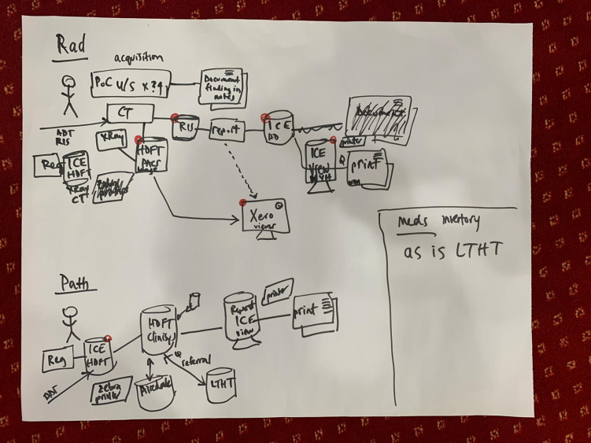
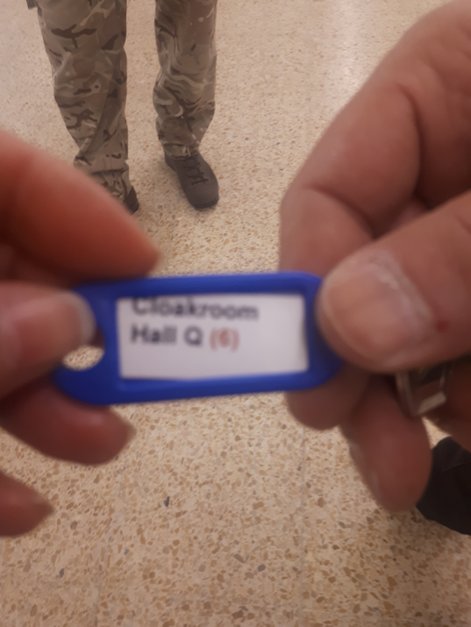
The Bad ie The Difficult
7 days/week until done – a time warp, felt like several months
Unknown & changing requirements
Physical layout challenging & changing – getting lost!
Very little digital infrastructure
People changed, i.e., re-explain & try not to re-evaluate
Too fast to remember names
Requirements changing eg # beds; needed to adjust quickly & move on
Last minute requirements that were also required – couldn’t just say no
“Any hands on deck” to do any job, including you … I didn’t know I could do desktop support!
Most lasting bad thing – KitKats and Crisps everyday
@CindyFedell
Notes:
own, npfit, make do
1st 2 weeks, no integration of dig into workflow; something else someone else did
Attention from the centre dq = poor people/process/tech combo (golden triangle)
Big hill
Eager; but zero confidence
Needed to show people what good looked like, started with Board-approved Guiding Principles
Importance of good data – not just at the minute use

Slide 7
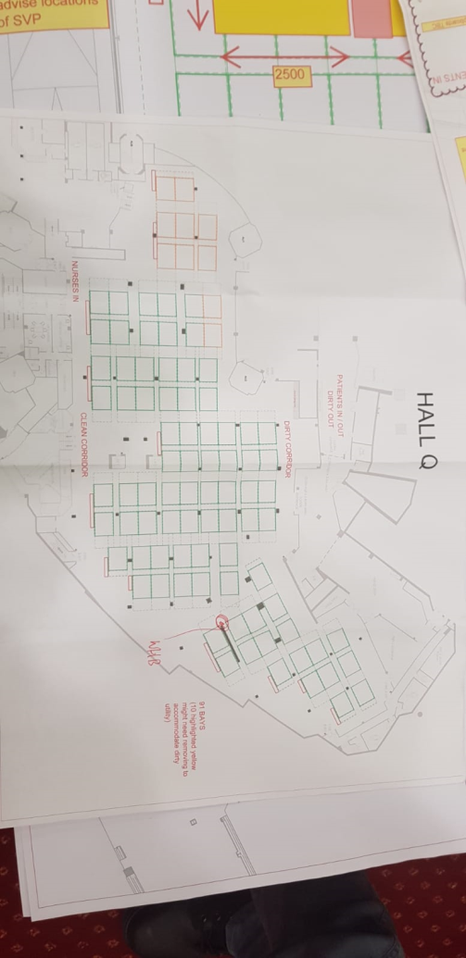
Lessons to try to take away
We can make reasonable decisions quickly but requires a catalyst and the right people
If we could only do sprints for everything
Could we keep:
Focus on getting something done
Swarming decision making
Leaps of faith
Trust including suppliers
ROC Drills
Sprint method
Doing reasonable things with core governance ie Cyber assessment & Go-Live review
If only we were all a bit further along in digital maturity, interfaces, YHCR …
The NHS can be agile!
@CindyFedell
Notes:
own, npfit, make do
1st 2 weeks, no integration of dig into workflow; something else someone else did
Attention from the centre dq = poor people/process/tech combo (golden triangle)
Big hill
Eager; but zero confidence
Needed to show people what good looked like, started with Board-approved Guiding Principles
Importance of good data – not just at the minute use

Slide 8
Q&A
@CindyFedell
Notes:
own, npfit, make do
1st 2 weeks, no integration of dig into workflow; something else someone else did
Attention from the centre dq = poor people/process/tech combo (golden triangle)
Big hill
Eager; but zero confidence
Needed to show people what good looked like, started with Board-approved Guiding Principles
Importance of good data – not just at the minute use

